Slide 1
Calculation Views

Slide 2
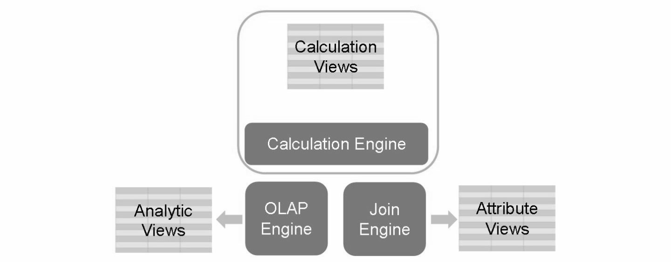
Creating Calculation Views
Calculation views are defined as either graphical views or scripted views depending on how they are created.
They can be used in the same way as analytic views, however, in contrast to analytic views it is possible to join several fact tables in a calculation view.
It is also possible to include more advanced calculations in a calculation view.
Business Example
We have created a data model with two analytic views, one for actual data and one for plan data. However we need to compare actual and plan data in a report.
One possible solution would be to create a calculation view to unify the two analytic view and to base a report on the calculation view.

Slide 3
Characteristics of calculation views
Supports both OLAP and OLTP models.
Supports complex expressions (i.e. IF, Case, Counter).
Supports reusing Analytic views, Attribute views and other Calculation views (Graphical and Scripted).
Supports analytic privileges (i.e. restricting a user for a certain cost center).
Supports SAP ERP specific features (i.e. client handling, language, currency conversion).
Provides ability to combine facts from multiple tables.
Provides support for additional data processing operations, (i.e. Union, explicit aggregation).
Provides ability to leverage specialized languages (i.e. R-Lang).
Provides ability to leverage both Column and Row tables.
Performance of certain operations (i.e. star-join, aggregation) are inferior to Analytical Views.
For an active calculation view, you can preview output data of an intermediate node.

Slide 4
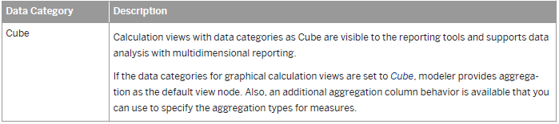
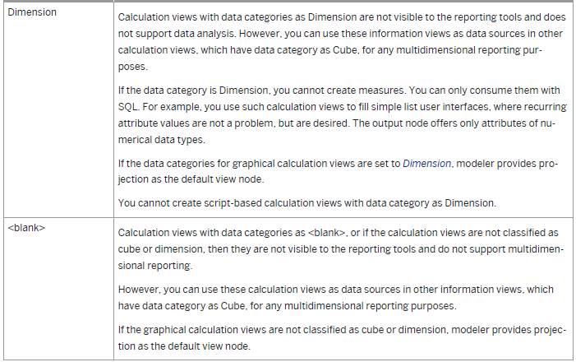

Slide 5
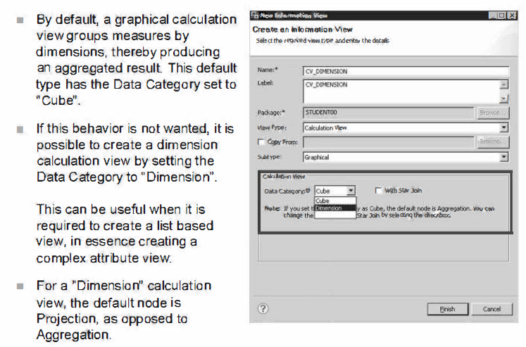
Dimension Calculation Views

Slide 6
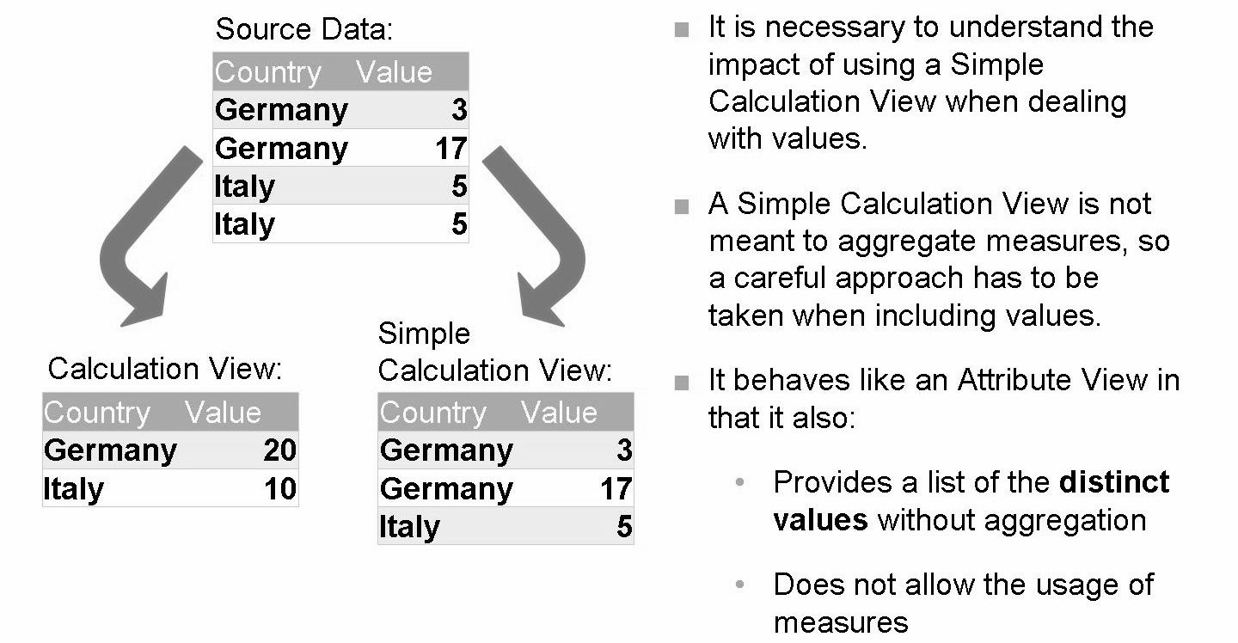
Dimension Calculation Views
Default node is Projection

Slide 7
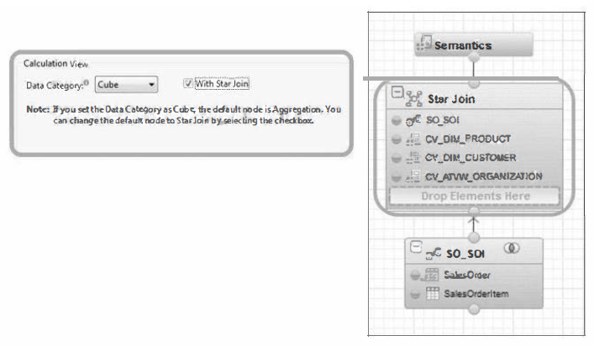
Star Join Node
If your source data for a graphical calculation view is of a star schema type, you can create a calculation view with a Star Join node.
You can only add calculation views with data category types as dimension or blank as a data source in star join node.
During deployment, the Star Join is always deployed with an aggregation node on top of it. The Star Join is deployed first with a series of joins and then the aggregation logic is deployed.

Slide 8
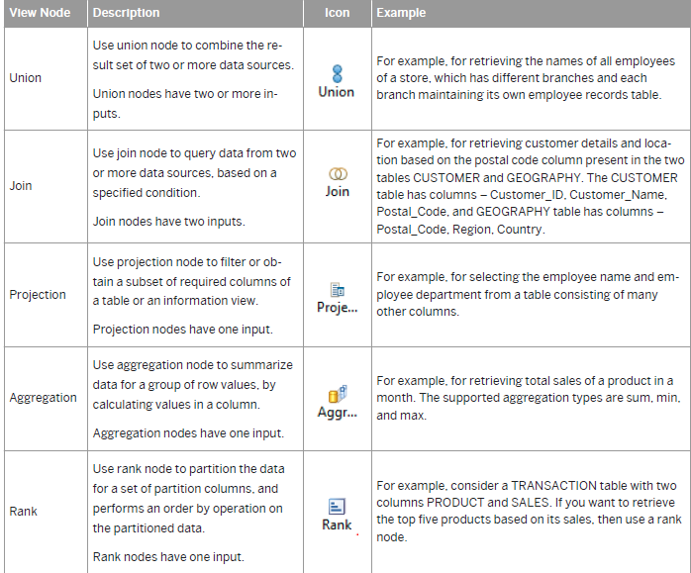

Slide 9
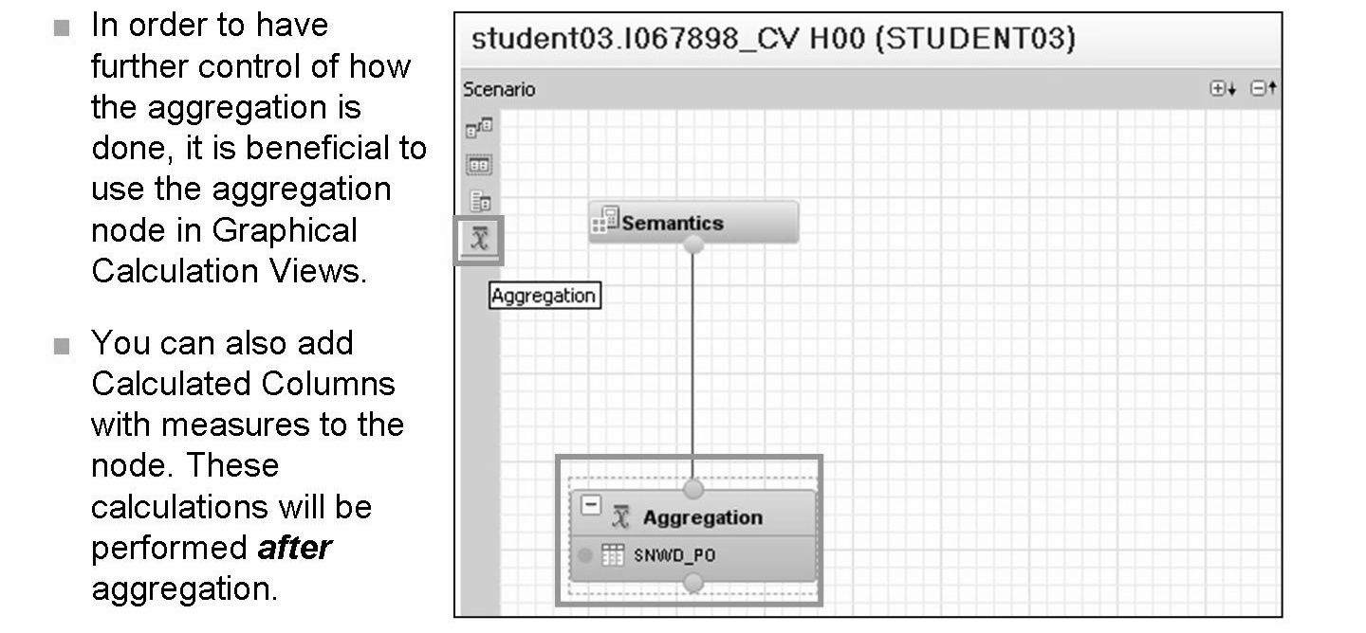
Aggregation Node
For restricted columns, modeler applies the aggregation type of the base column, and you can create restricted columns in the default aggregation view node or star join node only.

Slide 10
Join Node
Use join nodes in graphical calculation views to query data from two data sources.
The join nodes help limit the number of records or to combine records from both the data sources, so that they appears as one record in the query results.
By default, modeler consider the data source that you add first to the join node as the left table and the data source that you add next as the right table.
If you want to switch the left and right tables, in the context menu of the join, select Swap Left and Right Tables.
For text joins, always add the text table as the right table.

Slide 11
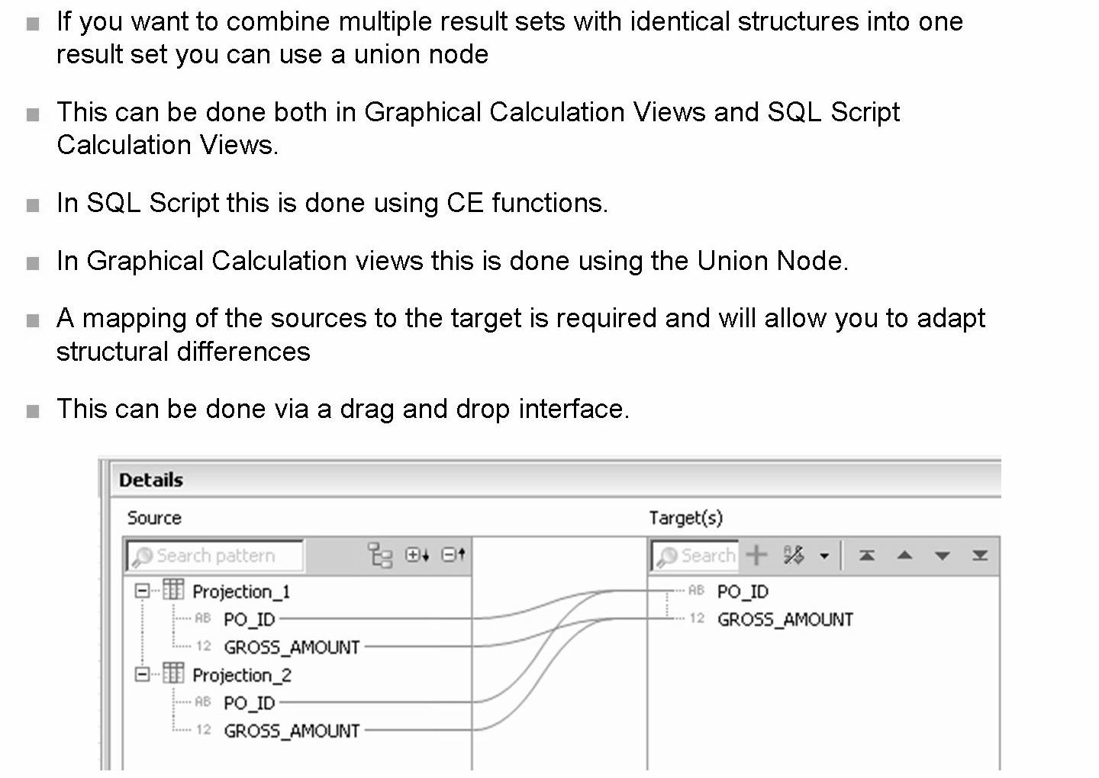
Union Node

Slide 12
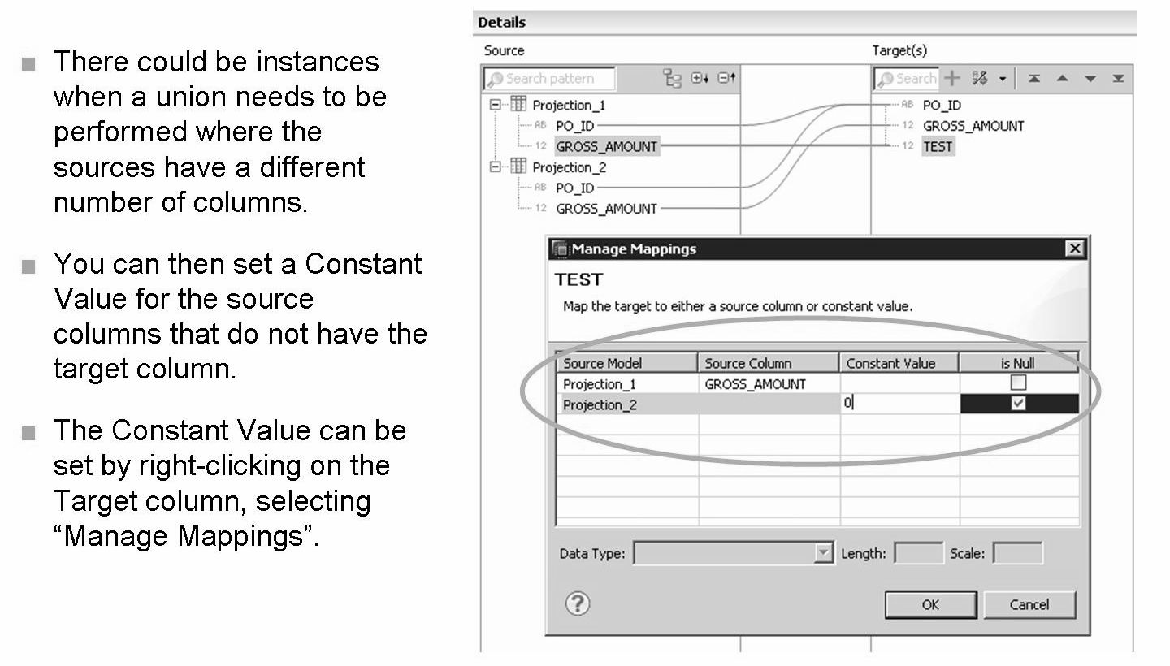
Union with constant value

Slide 13
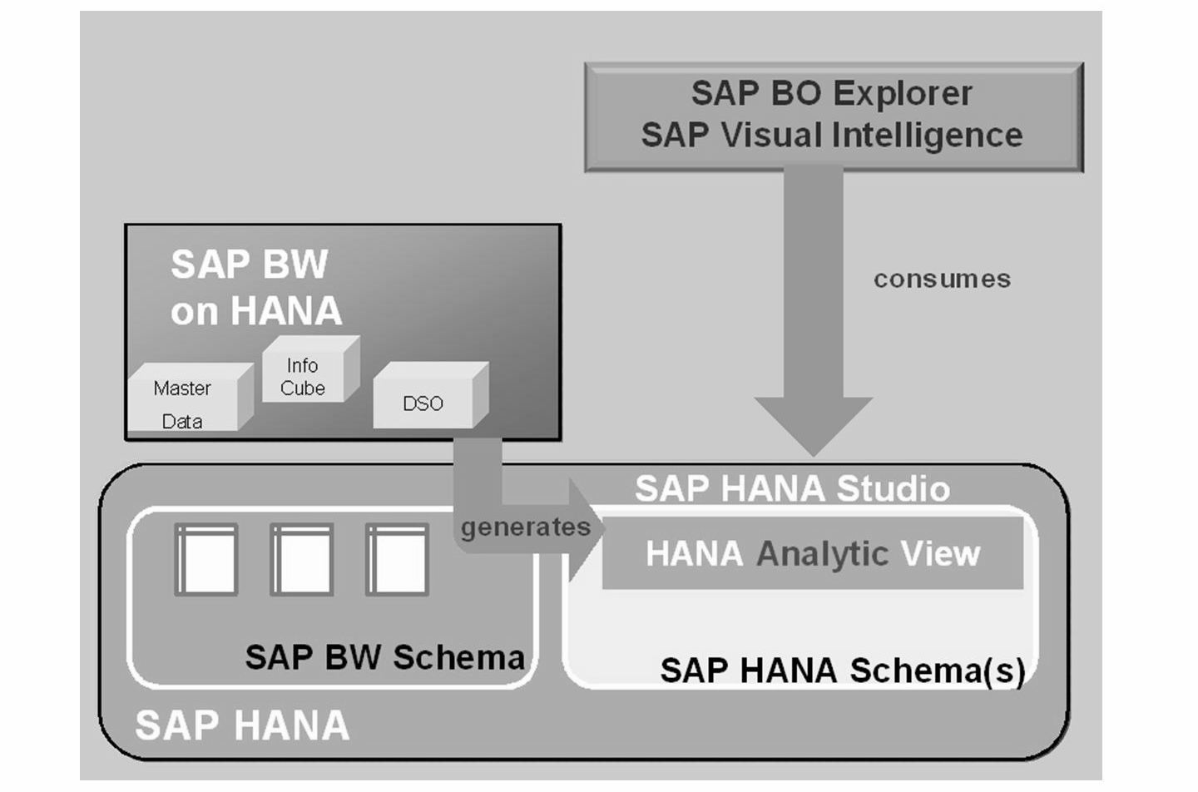
Analytic View Imported from BW Powered by SAP HANA
Another use of the Calculation View is to join an Analytic View from BW powered by SAP HANA to another Analytic View created directly into the SAP HANA Modeler.

Slide 14
THANK YOU
Courtesy : SAP Labs Document -
HA 300 – SAP HANA Implementation and Modeling

